Slide 1
Computational Physics U24568
Dr. Karen Masters
Dr. Daniel Whalen

Slide 2
Structure of Course
Hands on lab sessions (60 hours of lab/lecture time)
Learn by doing
3 hours of labs each week
Expect to follow-up labs with significant continuing work in your own time (notionally 200 hrs between now and April 2018, which is ~6 hours a week)
Assessment:
Portfolio of solutions from lab work (750 words; due December 2017; 40%)
Project (1250 words due April 2018, with a draft submission Feb 2018 for formative feedback; 60%)

Slide 3
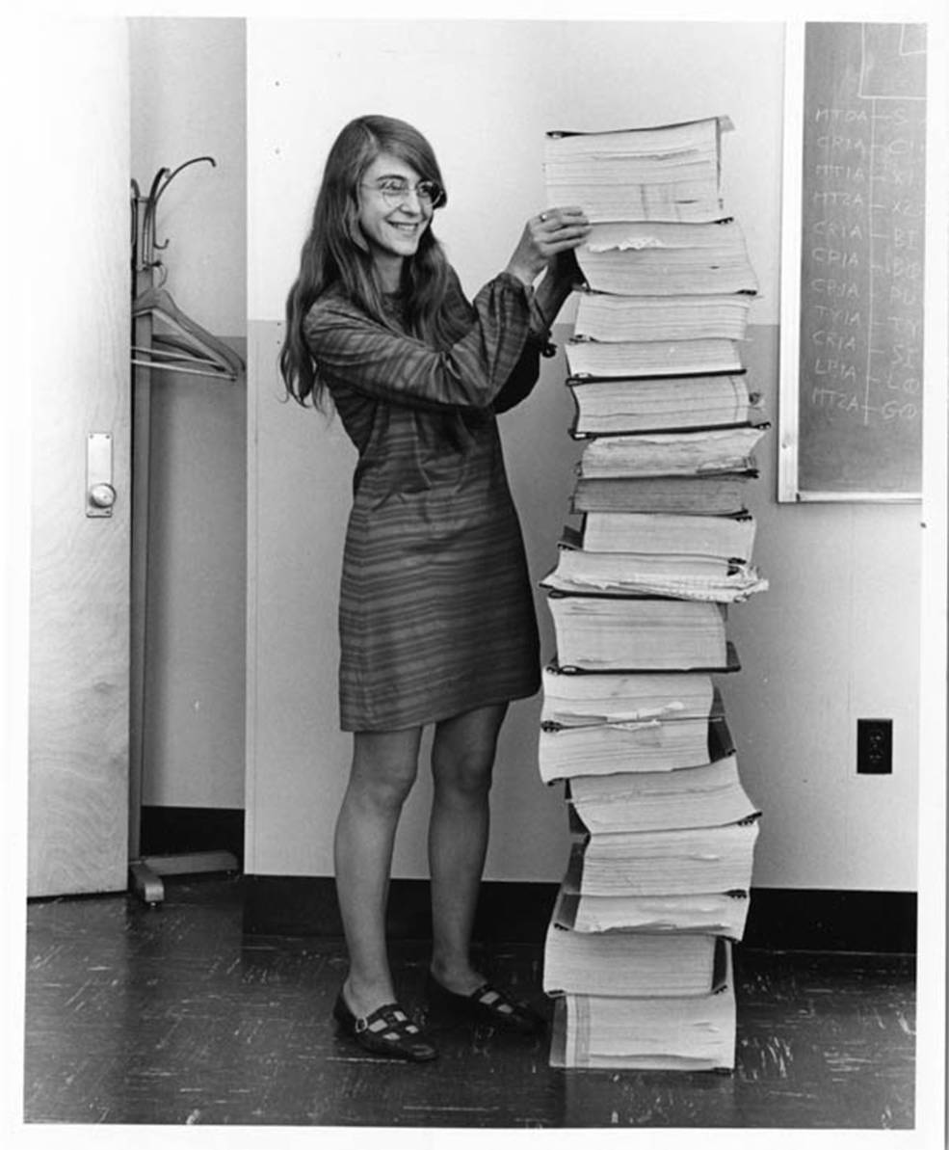
Aim of the Unit
Develop your skills and confidence for work in industry or academia
Add to your coding/computing CV (python, fortran, Linux, LaTeX, Github etc)
Give you the skills to do an excellent Project/Summer placement
Prepare you for Advanced Computational Techniques unit
Notes:
Hamilton in 1969, standing next to the navigation software that she and her MIT team produced for the Apollo project

Slide 4
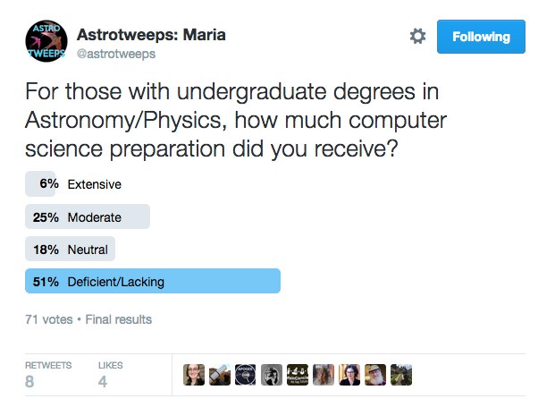
Typical Computing Background of Physics/Astronomy Undergraduates
Jennifer Sobeck

Slide 5
Locations
Burnaby Computer Lab (2.3)
King Henry Computer Lab (1.07)
Buckingham Computer Lab (0.07)
St Andrews Court Computer Lab (3.01)
Check your Timetable for time/location (might be others – and it changes).
Next class: Friday 6th October 3-6pm in Burnaby 2.3.

Slide 6
About the Lecturers
Dr Karen Masters (Reader in Astronomy and Astrophysics)
Elizabeth Swan (PhD student; python guru)
Dr. Daniel Whalen (Senior Lecturer; Unit Co-ordinator)

Slide 7
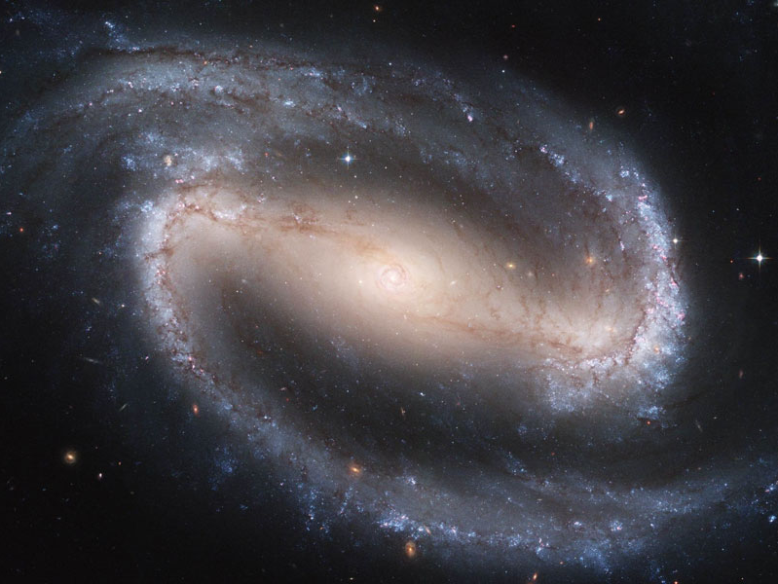
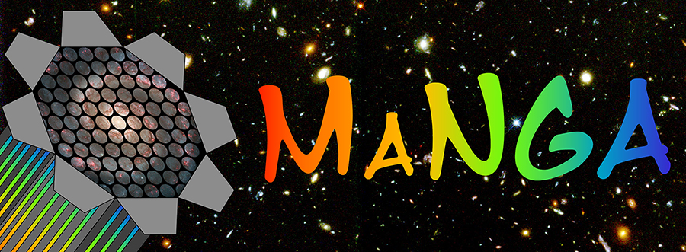



Galaxy Evolution with Big Datasets
Notes:
Galaxy evolution
Galaxy morphology – bars, spirals
Making use of crowdsourcing to do this for very large samples
Role of secular (slow/internal) evolution in disc galaxies
Galaxy dynamics (mostly disc galaxies)
Scaling relations (Tully-Fisher)
Testing modified gravity models

Slide 8
KLM’s Coding Background
Short introduction to Pascal (Oxford Physics Undergrad)
Summer placement – learned HTML to write a website, linux, more basic fortran, latex for paper writing.
3rd Year Project work in Fortran (wrote a programme to calculate orbital elements from 3 observations of Comet Alphonsina)
Graduate school at Cornell – in the deep end with linux and fortran, IRAF image analysis
Postdoctoral research at Harvard – made a switch to using IDL for data analysis (radio data)
Now – python is becoming the standard

Slide 9
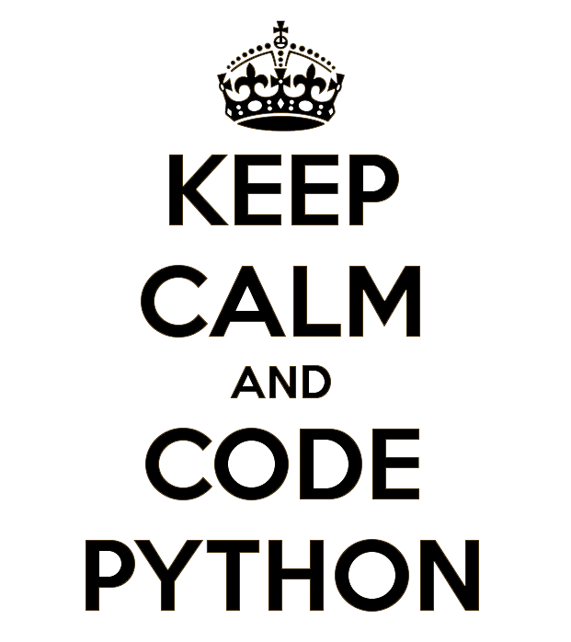

Slide 10
What is Python?
Python is a widely used high-level, general-purpose programming language
Python design philosophy emphasizes code readability
syntax allows programmers to express concepts in fewer lines of code than many other langauges
Highly extensible – ie. you can call out to other languages/programmes very easilly
Philosophy of Python
Beautiful is better than ugly
Explicit is better than implicit
Simple is better than complex
Complex is better than complicated
Readability counts

Slide 11
Why Python?
it gives you another language to list on you CV
Learning multiple languages will give you confidence that you can pick up any coding language you need
Python is a sought after language by the employers of physicists (slightly overtaking Matlab in recent years)
it's free and open source (you don't need a license)
It comes with lots of useful scientific libraries

Slide 12
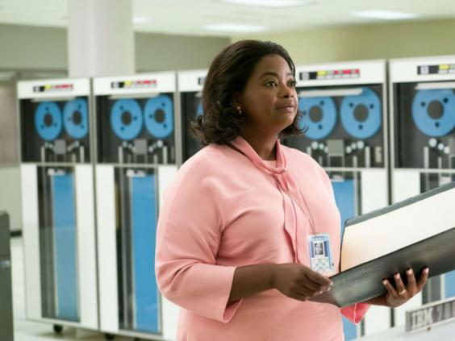
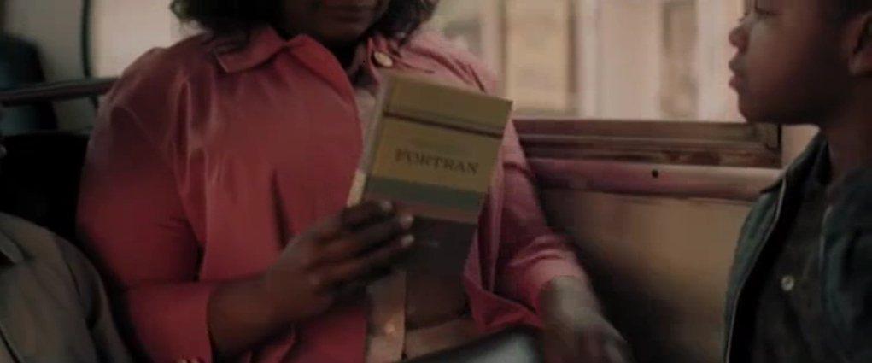
Fortran
Developed in 1954
Language learned by the NASA “Computers” in Hidden Figures.
Rarely used in industrial applications today (not in top 25)
Remains dominant language for large scale simulation of physical systems, ie. for things like the astrophysical modeling of stars and galaxies, hydrodynamics codes
It’s FAST
Lots of “legacy code”
Why Physicists still use Fortran: http://moreisdifferent.com/2015/07/16/why-physicsts-still-use-fortran/

Slide 13

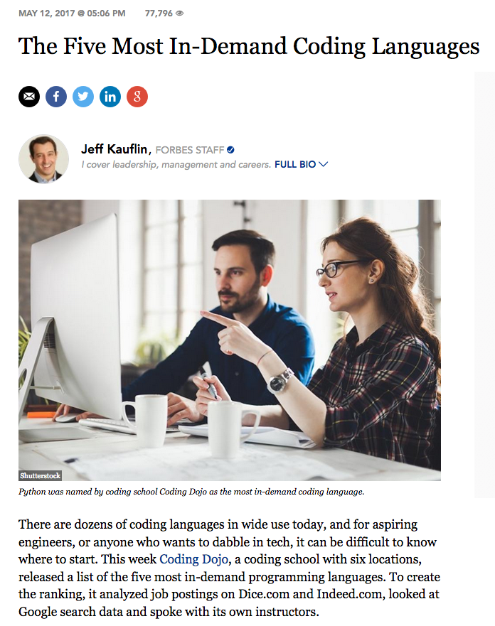

Slide 14
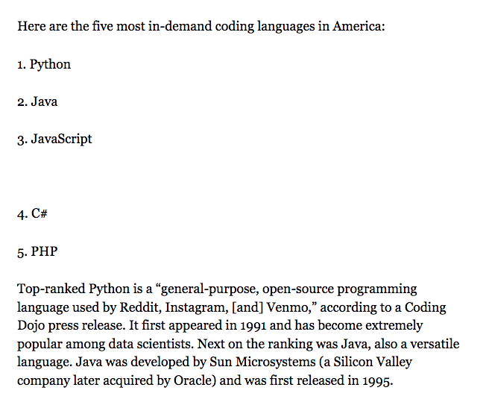

Slide 15
Top Tips for Success in Coding

Slide 16
Top Tips for Success in Coding
Computational Physics
Computational physicists use computer code, but they are not coders
Skills needed to set up the problems are as important as the coding itself
Not (generally) coding for production code, nor focused on the code alone

Slide 17
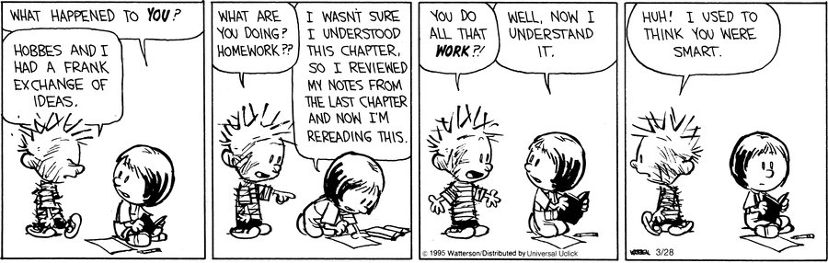
Top Tips for Success in Comp Phys
1. Practice makes perfect. Attend lab sessions for help (or code alone during the time).
2. Practice makes perfect. Expect to spend significant time working through coding examples outside of lab.
3. Practice makes perfect.

Slide 18
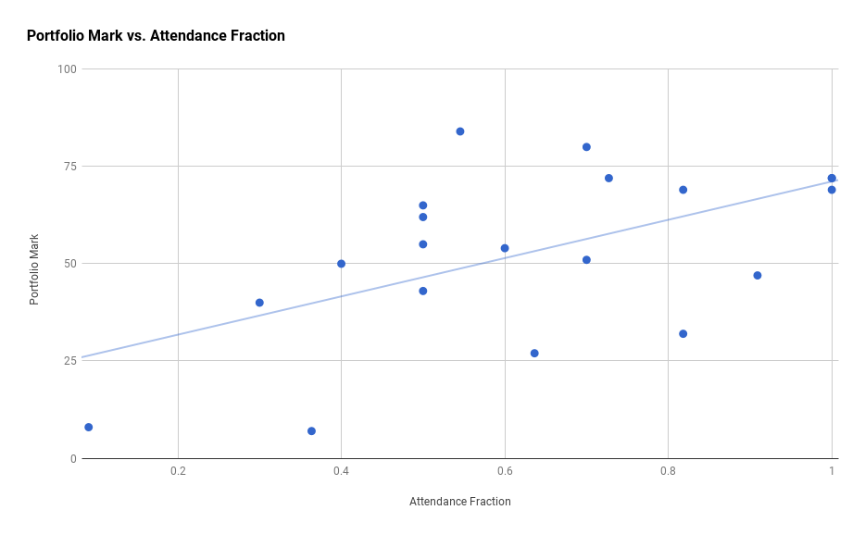

Slide 19
Top Tips for Success in Comp Phys
Just try it (although be careful about infinite loops!)
Google is your friend (seriously)
Ask for help
Peer learning (ask your friends)
Come to lab and ask Lizi or me.

Slide 20
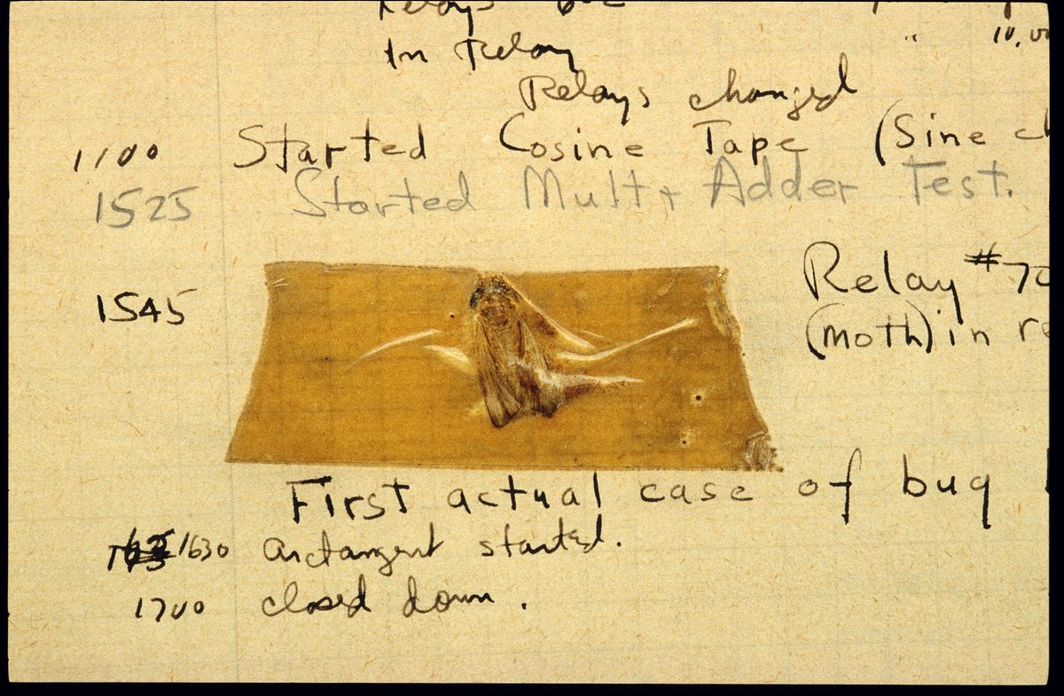
Debugging
Check for typos
Include “print” statements to find location of errors (i.e. where does the code run to)
Google “python” plus the error message
Take a break (fresh eyes help)
Ask for help (see above)
It’s always a typo/error – you just have to find it
Notes:
The terms "bug" and "debugging" are popularly attributed to Admiral Grace Hopper in the 1940s.^{[1]} While she was working on a Mark II computer at Harvard University, her associates discovered a moth stuck in a relay and thereby impeding operation, whereupon she remarked that they were "debugging" the system. However the term "bug" in the meaning of technical error dates back at least to 1878 and Thomas Edison (see software bug for a full discussion). Similarly, the term "debugging" seems to have been used as a term in aeronautics before entering the world of computers.

Slide 21
Python for Physicists Tutorial
Work through the notes available on Moodle for a Python for physics tutorial
DEMO
As your self guided work this week please complete working through all examples in Chapter 2 of Newman (link on Moodle) until 2.4.3.
If this is easy for you (e.g. takes less than an hour), please try to do some of the Exercises.

